Slide 1
Java History
1) JAVA was developed by Sun Microsystems Inc in 1991, later acquired by Oracle Corporation.
2) It was developed by James Gosling and Patrick Naughton and team called as green team.
3) Initially it developed for electronic devices like set-up box, television etc. However, it was suited for internet programming
4) Later, Java technology was incorporated by Netscape.
5) It is a simple programming language. Writing, compiling and debugging a program is easy in java.
6) It helps to create modular programs and reusable code.
7) Firstly, it was called "Greentalk" by James Gosling, and the file extension was .gt.
8) After that, it was called Oak and was developed as a part of the Green project.
9) Oak is a symbol of strength and a national tree of many countries like the U.S.A., France, Germany, Romania, etc.
10) In 1995, Oak was renamed as "Java" because it was already a trademark by Oak Technologies.

Slide 2
Java Versions
JDK Alpha and Beta (1995)
JDK 1.0 (23rd Jan 1996)
JDK 1.1 (19th Feb 1997)
J2SE 1.2 (8th Dec 1998)
J2SE 1.3 (8th May 2000)
J2SE 1.4 (6th Feb 2002)
J2SE 5.0 (30th Sep 2004)
Java SE 6 (11th Dec 2006)
Java SE 7 (28th July 2011) LTS
Java SE 8 (18th Mar 2014) LTS
Java SE 9 (21st Sep 2017)
Java SE 10 (20th Mar 2018)
Java SE 11 (Sept 2018) LTS
Java SE 12 (Mar 2019)
Java SE 13 (Sept 2019)
Java SE 14 (Mar 2020)
Java SE 15 (Sept 2020)
Java SE 16 (Mar 2021)
Java SE 17 (Sept 2021) LTS

Slide 3
Features of Java
1) Simple :
It’s easy to learn as its syntax is similar to english .
If you know c and c++ then its more easy to learn Java.
2) Object-Oriented
Each and everything in java is based on object
OOPS is based on four pillars Encapsulation, Polymorphism, Inheritance , Abstraction
3) Secure
Java programs are checked for error at compile time and run time.
When we compile java code it creates .class file which is in unreadable format.
4) Platform Independent
Java programs created on one platforms can run on any platform
5) Interpreted
Each and every code in java is interpreted at runtime

Slide 4
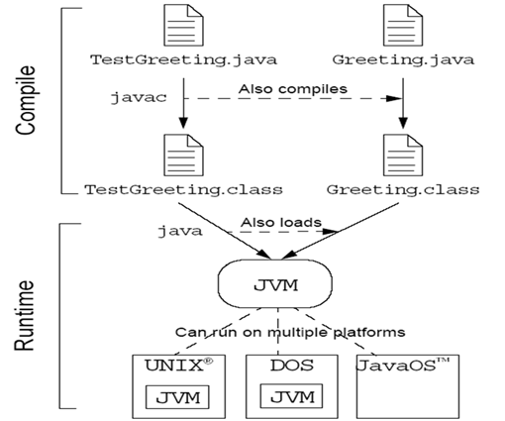
Program Execution

Slide 5
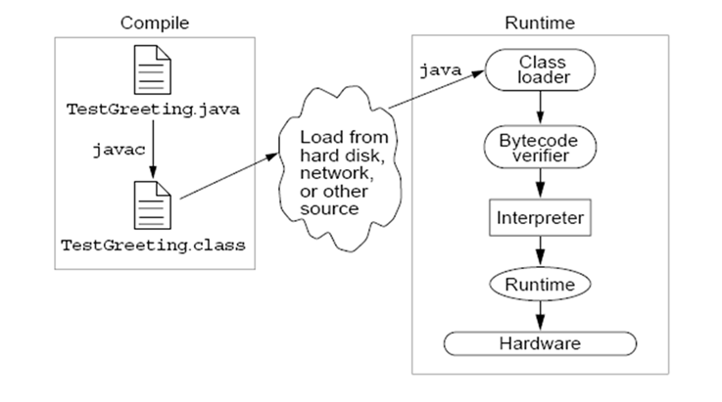
Java Runtime Environment (JRE)

Slide 6
JVM Tasks
Loading: It is performed by the class loader to load the code.
Verifying: It is performed by the bytecode verifier to verify the code.
Executing: It is performed by the runtime interpreter to execute the code.

